Slide 1
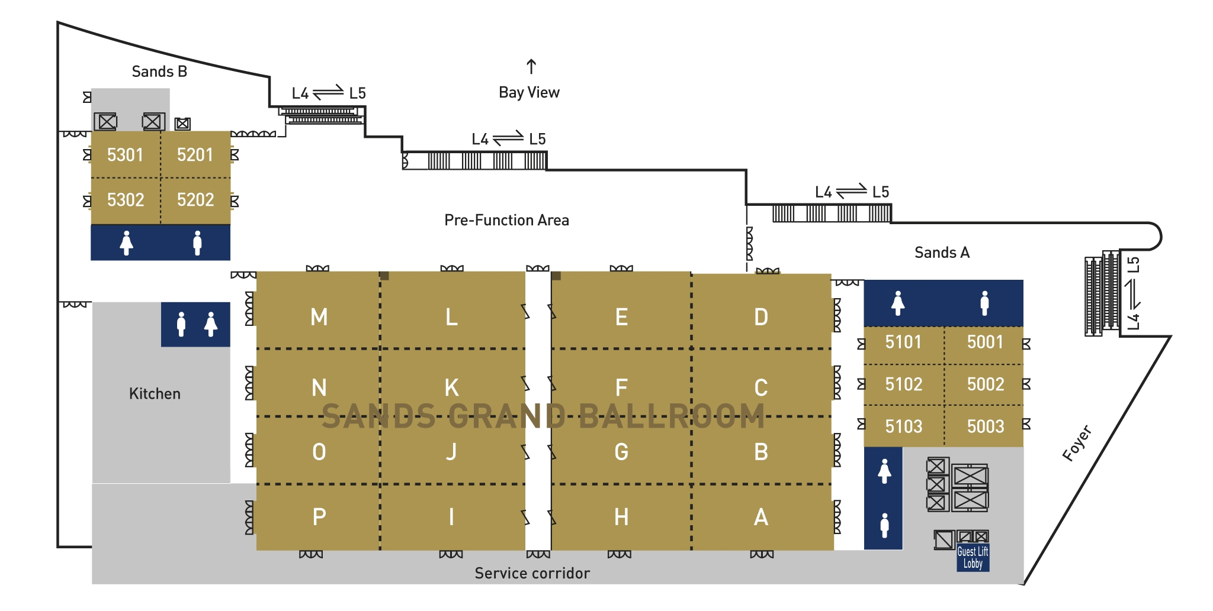
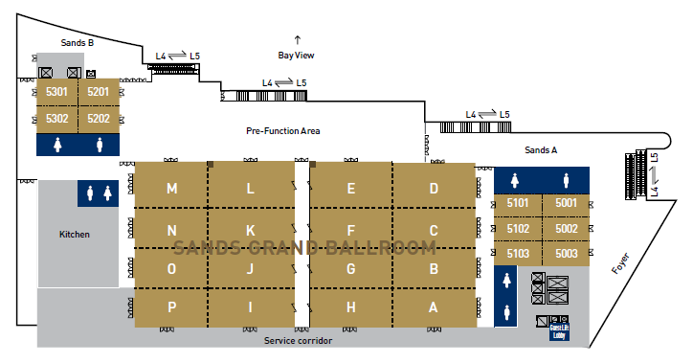
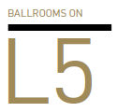
LEVEL 5 BALLROOMS
Registration
Training Village
Room 2
Plenary
Room 3
Exhibition
Preview
Room 4
Interactive Case Corner
?
Room dimensions do not include space at the entrance or set-in area of the closet. Room capacity information is based on maximum space available.
Allowance must be made for elaborate audio-visual equipment and production setup.
The Sands Grand Ballroom on Level 5 is the perfect venue for large and lavish events. The space can be configured into 16 rooms to hold simultaneous meetings. In addition, there are 2 more ballrooms to supplement the Sands Grand Ballroom.

